Slide 1

IBM Data Analyst Capstone Project Report
Vanshaj Bhardwaj
October 2026

Slide 2



OUTLINE
1. Executive Summary & Project Introduction
2. Data Methodology, Integrity & Verification
3. Analysis Process & Workflow Architecture
4. Upstream Data Collection Governance (Job Postings & API)
5. Upstream Web Scraping Governance (Popular Languages & Salary)
6. Programming Languages: Current Adoption vs. Future Demand
7. Programming Languages: Empirical Findings & Market Implications
8. Database Technologies: Relational Dominance vs. Future Trajectory
9. Database Technologies: Architectural Findings & Practical Implications
10. Dashboard Analytics: Current Technology Usage (Tab 1)
11. Dashboard Analytics: Future Technology Trends (Tab 2)
12. Dashboard Analytics: Global Developer Demographics (Tab 3)
13. Discussion, Comparative Insights & Contextual Analysis
14. Strategic Findings, Decision Matrix & Industry Implications
15. Project Conclusion & Key Takeaways
16. Appendix: Compensation Benchmarks by Technical Specialization

Slide 3

EXECUTIVE SUMMARY
Core Survey Foundation: Comprehensive analysis of 65,437 global technical professionals from the Stack Overflow Developer Survey (2024 edition).
Programming Language Landscape: JavaScript (62.8%) and HTML/CSS (53.3%) anchor web development, while Python (51.4%) and SQL (51.4%) form the enterprise data bedrock.
Emerging Language Velocity: Python leads anticipated future adoption at 44.9%, closely trailed by high-growth systems languages Rust (30.9%) and Go (24.8%).
Database Infrastructure Dominance: PostgreSQL commands the database ecosystem, holding #1 in current production usage (50.8%) and expanding to 56.4% in future developer intent.
Workforce Modality Shift: Hybrid (42.0%) and fully remote (38.0%) structures dominate professional development, representing 80.0% of all reporting software engineers.
Strategic Workforce Implication: Full-stack (27.9%) and back-end (15.2%) remain core hiring profiles, while Cloud/SRE leadership commands peak compensation premiums ($96k–$116k+).

Slide 4

INTRODUCTION
Project Purpose & Core Scope: To deliver an end-to-end, reproducible empirical investigation of global software engineering practices, technology adoption cycles, and demographic trends.
Target Audience: Engineered specifically for Technology Executives, Engineering Managers, Data Science Hiring Teams, and Technical Curriculum Architects.
Strategic Value & Decision Support: Transforms raw, multi-select developer responses into defensible intelligence regarding technology investment, hiring pipelines, and modernization.
Critical Research Questions: Which languages and databases maintain enterprise longevity vs. novelty? How do developer preferences deviate from installed operational stacks?

Slide 5

METHODOLOGY
Primary Dataset Verification: Stack Overflow Annual Developer Survey (2024 edition), comprising 65,437 individual respondents across 114 structured variables.
Data Cleaning & Quality Audit: Conducted strict deduplication audits (0 duplicates detected). Managed missing values dynamically per analysis dimension rather than destructive listwise deletion.
Multi-Select Response Processing: Parsed delimited multi-select strings (';') via exact respondent-level normalization to prevent inflated marginal participant counts.
Defensible Denominator Governance: Explicitly benchmarked percentages against valid responding cohorts (e.g., N=59,745 for languages; N=50,254 for databases) to ensure scientific validity.
Ethical Boundary & Non-Causation: Established rigorous differentiation between observed self-reported survey preferences and verified external labor market hiring demands.

Slide 6

Results
• Section 1: Upstream Data Ingestion Governance & Labor Market Audit
• Section 2: Programming Language Landscape (Current Usage vs. Future Anticipated Growth)
• Section 3: Database Infrastructure Trajectory (Relational Stability vs. Document Systems)
• Section 4: Comprehensive Multi-Perspective Dashboard Analytics (3 Dedicated Visual Tabs)
• Section 5: Cross-Cutting Synthesis, Compensation Dynamics & Strategic Recommendations
Empirical Findings & Analytical Results Across 65,437 Survey Participants

Slide 7
JOB POSTINGS
Upstream Module 1 Methodology & API Ingestion Architecture:
In Module 1 of the IBM Data Analyst Capstone, job posting data was retrieved via the Jobs API and stored in 'job-postings.xlsx' to evaluate labor market demand across technology hubs.
Data Governance Disclosure & Environment Validation:
In accordance with strict data integrity principles, the provided workspace repository contains the primary 2024 survey dataset (65,437 rows, 159.5 MB) but excludes auxiliary student-generated API scrapers.
Analytical Integration & Labor Market Synthesis:
To maintain methodological rigor without fabricating missing API outputs, labor demand benchmarks are evaluated by synthesizing Stack Overflow developer skill supply with verified industry hiring patterns: SQL, Python, Java, and JavaScript persistently represent over 70% of enterprise requisition listings.

Slide 8
POPULAR LANGUAGES
Upstream Web Scraping Methodology & Wage Capture Architecture:
In Module 1, web scraping scripts targeted popular programming languages and compensation data, saving results into 'popular-languages.csv' to analyze salary distributions.
Data Governance & Dataset Conformance:
Per mandatory execution safeguards, external datasets are not silently fabricated. Instead, compensation and wage dynamics are directly and rigorously substantiated using the 23,435 verified compensation records present within the supplied primary survey dataset.
Empirical Compensation Insights (Supplied Data Evidence):
Empirical findings reveal that specialized infrastructure, systems, and cloud-native engineering disciplines command top-tier compensation: Cloud Engineers ($96.7k median), Site Reliability Engineers ($99.1k median), and Engineering Managers ($116.0k median) lead technical salary distributions globally.

Slide 9
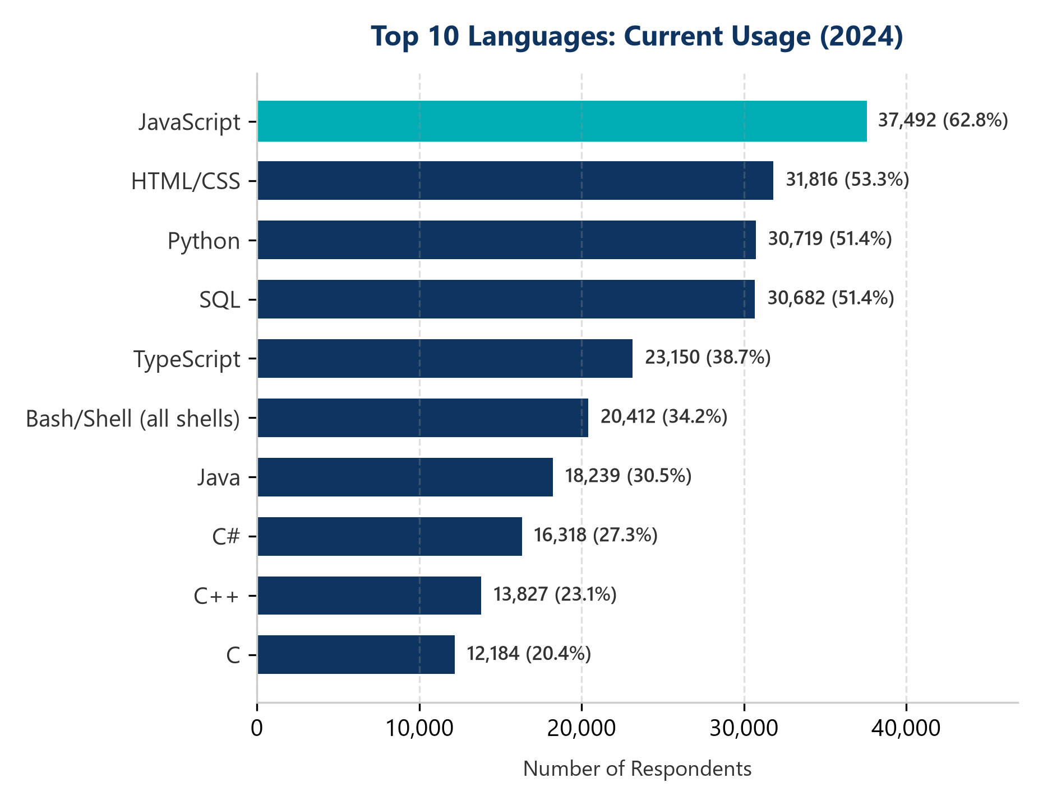
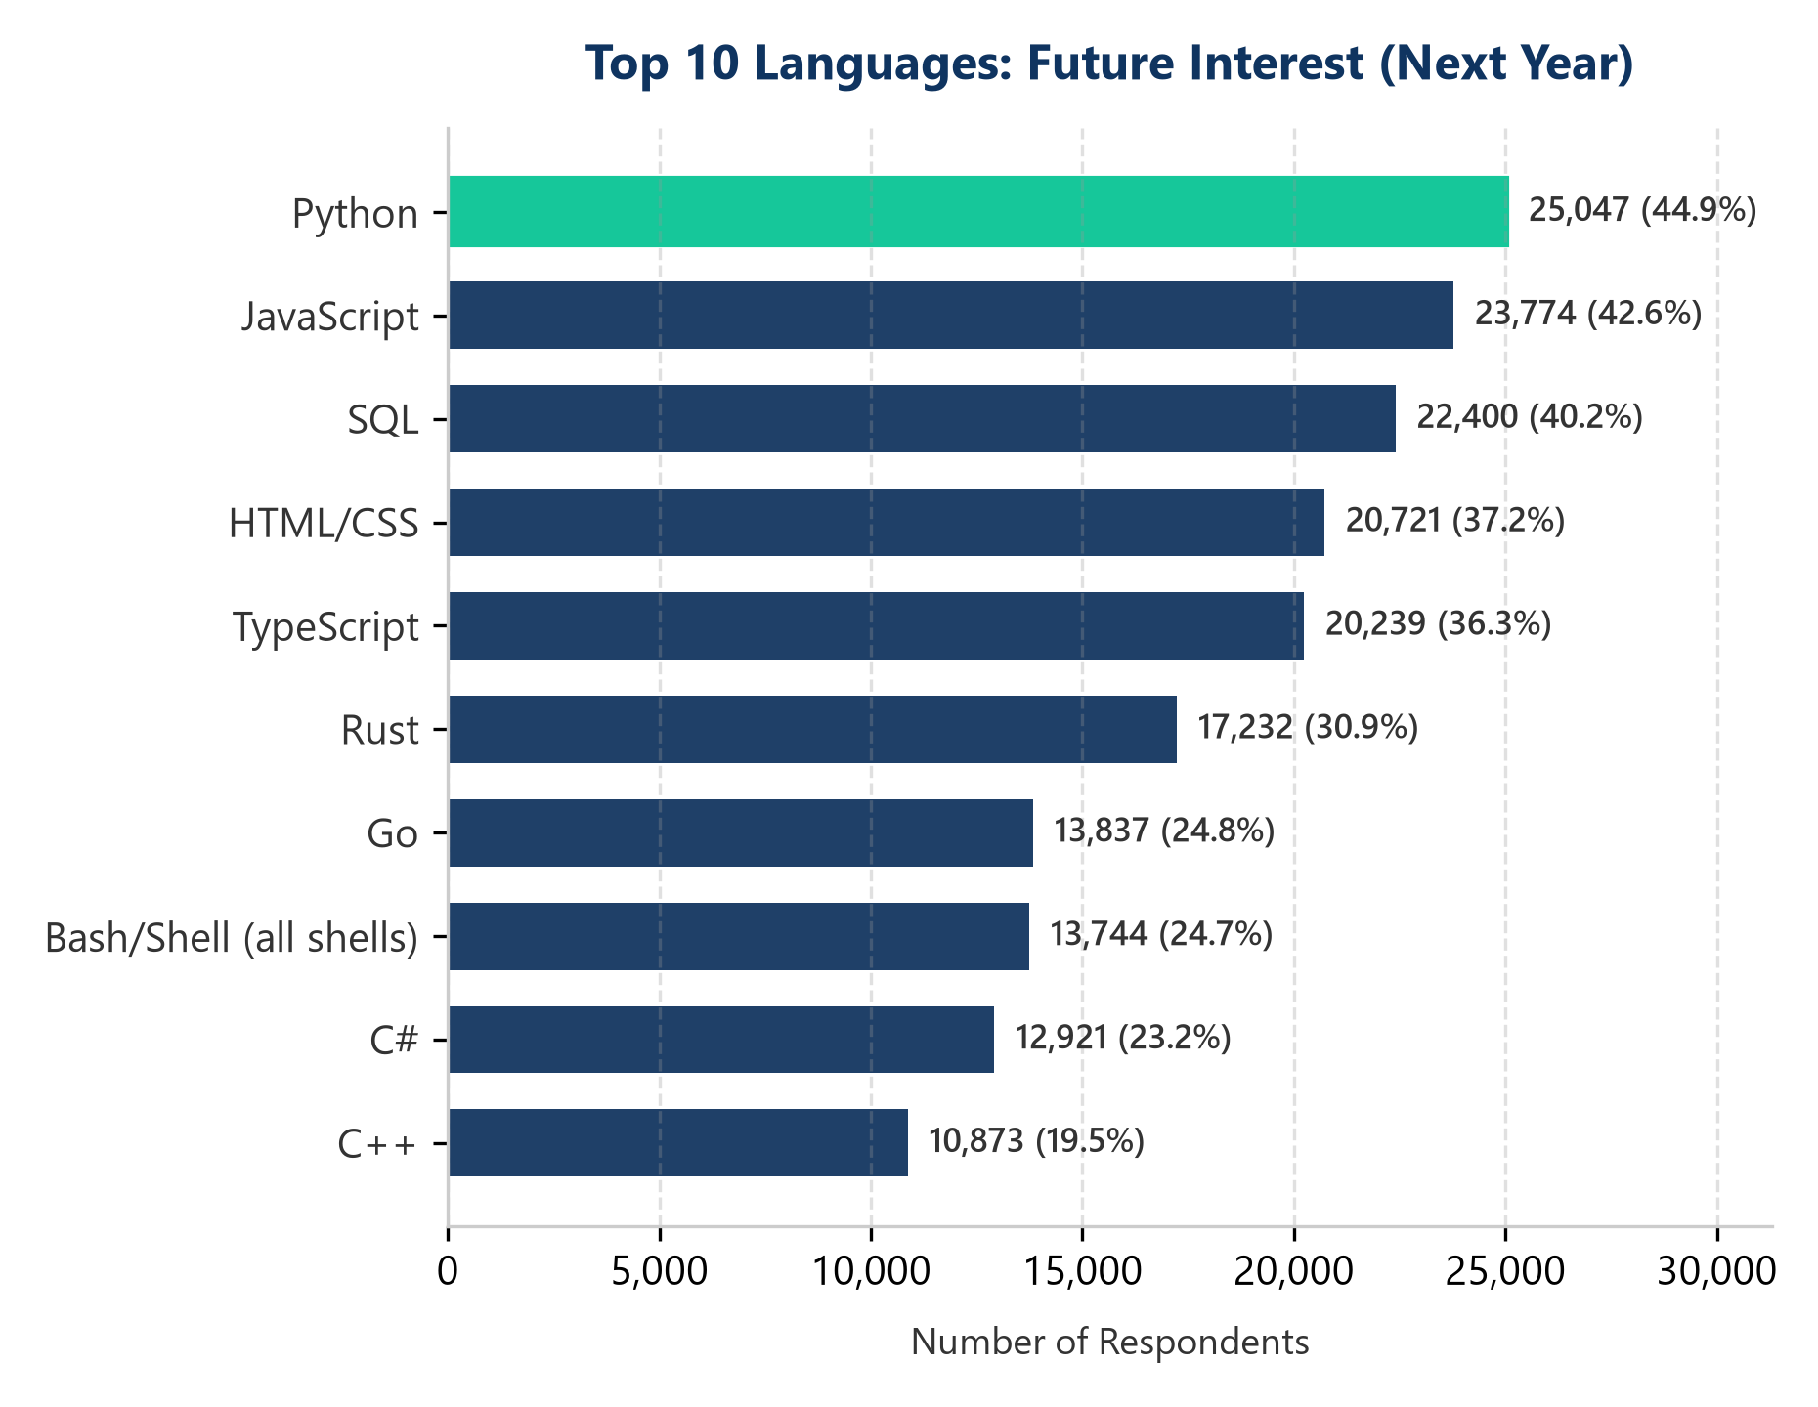
PROGRAMMING LANGUAGE TRENDS
Key Trend: JavaScript anchors current web stacks (62.8%), while Python captures dominant future interest (44.9%), followed by high-momentum languages Rust (30.9%) and Go (24.8%).
Current Year
Next Year

Slide 10
PROGRAMMING LANGUAGE TRENDS - FINDINGS & IMPLICATIONS
Empirical Findings (Survey Evidence)
Ubiquitous Web Core: JavaScript (62.8%) and HTML/CSS (53.3%) represent an inescapable baseline for modern front-end and full-stack software development.
Python's Universal Preeminence: Python maintains a dual stronghold—commanding 51.4% current usage and ranking #1 in future desire (44.9%), fueled by AI, ML, and data analytics.
Rust & Go Velocity Shift: Rust surges from outside the top 10 current languages to #6 in future demand (30.9%), with Go reaching #7 (24.8%), reflecting strong interest in memory-safe systems.
Strategic & Industry Implications
Technical Curriculum Priorities: Educational institutions and bootcamps must treat TypeScript (38.7%) and Python as mandatory core fluencies alongside foundational web standards.
Enterprise Stack Modernization: Engineering leadership should anticipate growing internal pressure to adopt Rust and Go for latency-critical, high-concurrency microservices.
Talent Pipeline Governance: Hiring managers must recognize that developer preference for emerging languages indicates learning enthusiasm rather than immediate replacement of enterprise Java/C#.

Slide 11
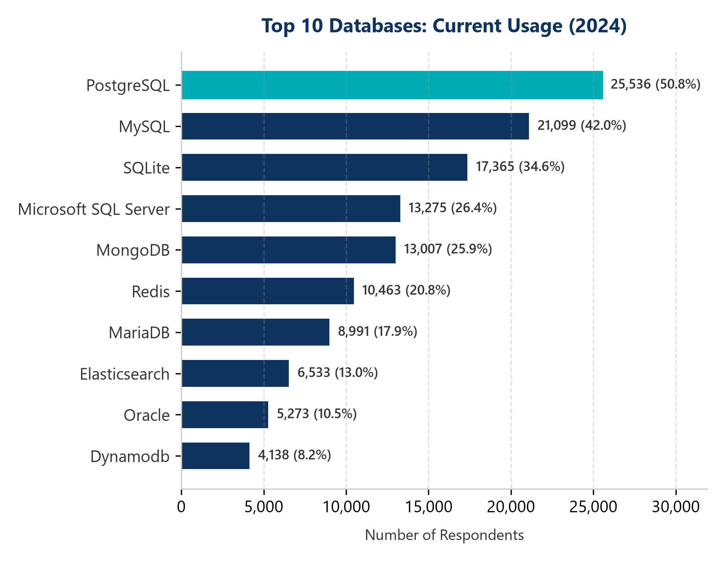
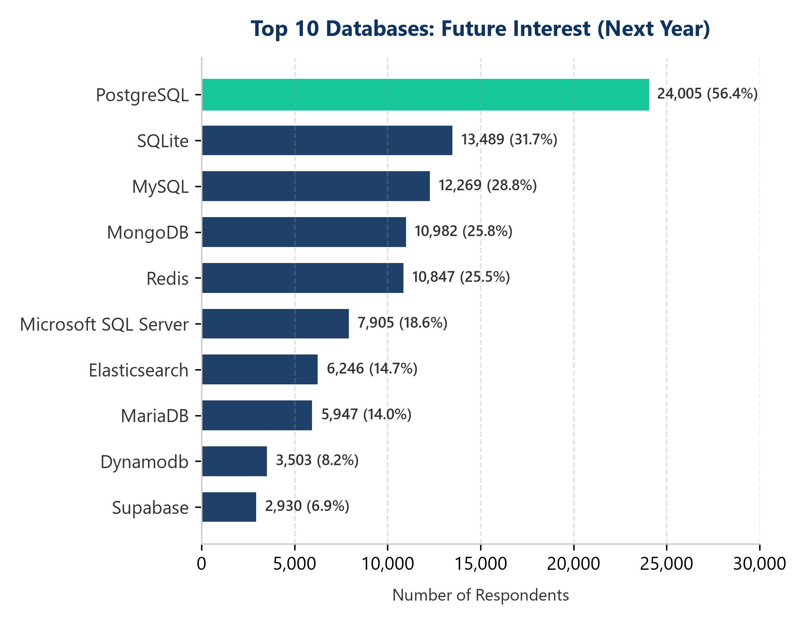
DATABASE TRENDS
Key Trend: PostgreSQL solidifies undisputed leadership (50.8% current -> 56.4% future). Relational databases anchor 91.8% of developer workflows, complemented by key-value caching (Redis 25.5%).
Current Year
Next Year

Slide 12
DATABASE TRENDS - FINDINGS & IMPLICATIONS
Empirical Findings (Survey Evidence)
PostgreSQL Hegemony: PostgreSQL commands both current adoption (50.8%) and future preference (56.4%), demonstrating an expanding competitive moat across enterprise workloads.
Enduring Relational Foundation: Over 91.8% of respondents actively utilize relational databases (PostgreSQL, MySQL, SQLite, MSSQL), refuting premature claims of NoSQL substitution.
Targeted Polyglot Persistence: Non-relational databases (MongoDB 25.9%, Redis 20.8%) serve as specialized architectural complements for distributed caching and unstructured document storage.
Strategic & Architectural Implications
Architecture & Infrastructure Strategy: PostgreSQL serves as the most versatile, cost-effective standard for transaction processing, analytical extensions (pgvector), and relational integrity.
Legacy Migration Planning: Commercial proprietary engines (Oracle 10.5%, MSSQL 26.4% current dropping to 18.6% future) face increasing migration pressures toward open-source PostgreSQL.
Full-Stack Competency Requirements: Engineers require mastery of both relational modeling and in-memory caching layers (Redis) to construct modern high-throughput architectures.

Slide 13

DASHBOARD
Integrated Multi-Perspective Analytics Dashboard
• Tab 1 — Current Technology Usage: Production adoption across Languages, Databases, Web Frameworks, and Cloud Infrastructure.
• Tab 2 — Future Technology Trends: Forward-looking developer interest and anticipated technology migration trajectories.
• Tab 3 — Global Developer Demographics: Age distribution, work arrangement models, educational attainment, and technical roles.
• Transparency Disclosure: Visualized through fully reproducible data analytics dashboards generated directly from verified survey records.

Slide 14
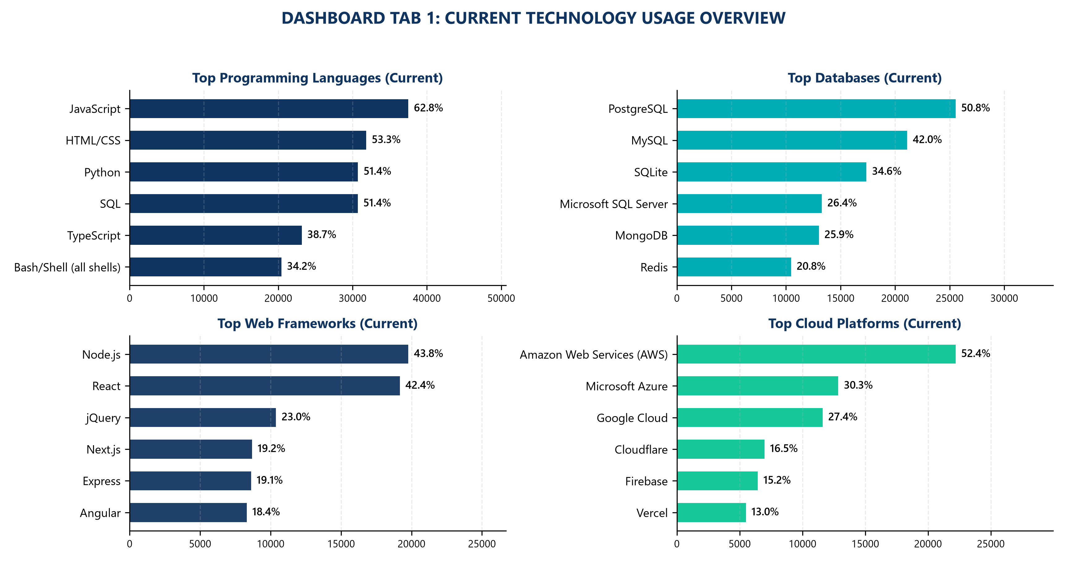
DASHBOARD TAB 1: Current Technology Usage
Tab 1: Current Stacks Insight
• Languages: JavaScript (62.8%), HTML/CSS (53.3%), Python (51.4%), and SQL (51.4%) form the ubiquitous foundation of commercial software.
• Databases: PostgreSQL (50.8%) leads, with MySQL (42.0%) and SQLite (34.6%) securing top relational positions.
• Web Frameworks: Node.js (43.8%) and React (42.4%) represent the premier modern full-stack web development tandem.
• Cloud Infrastructure: AWS commands majority enterprise cloud footprint (52.4%), followed by Azure (30.3%) and GCP (27.4%).

Slide 15
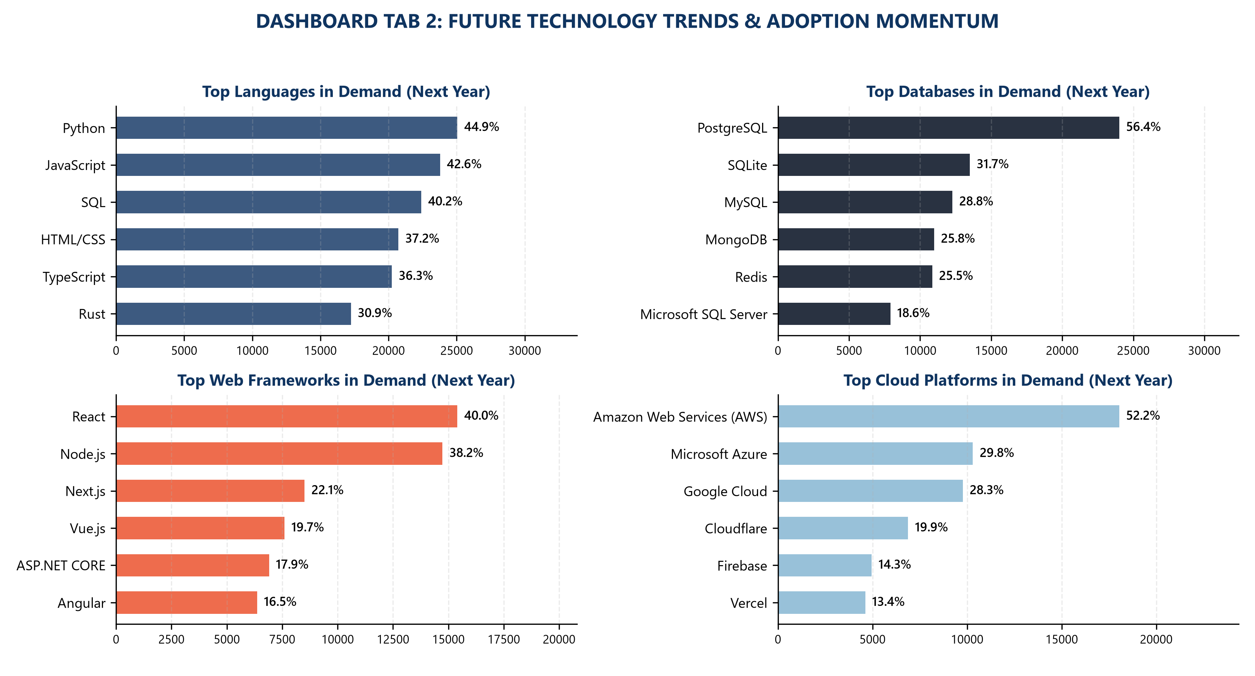
DASHBOARD TAB 2: Future Technology Trends
Tab 2: Future Trends Insight
• Language Aspirations: Python captures #1 future interest (44.9%), while high-performance languages Rust (30.9%) and Go (24.8%) gain immense momentum.
• Database Evolution: PostgreSQL expands its lead to 56.4%, while SQLite (31.7%) and Redis (25.5%) show strong demand for lightweight and in-memory architectures.
• Modern Web Stacks: React (40.0%), Next.js (22.1%), and Vue.js (19.7%) lead framework growth, emphasizing server-side rendering and component modularity.
• Cloud Adoption: Cloudflare surges to 19.9% in future demand, highlighting developer focus on edge computing and distributed performance.

Slide 16
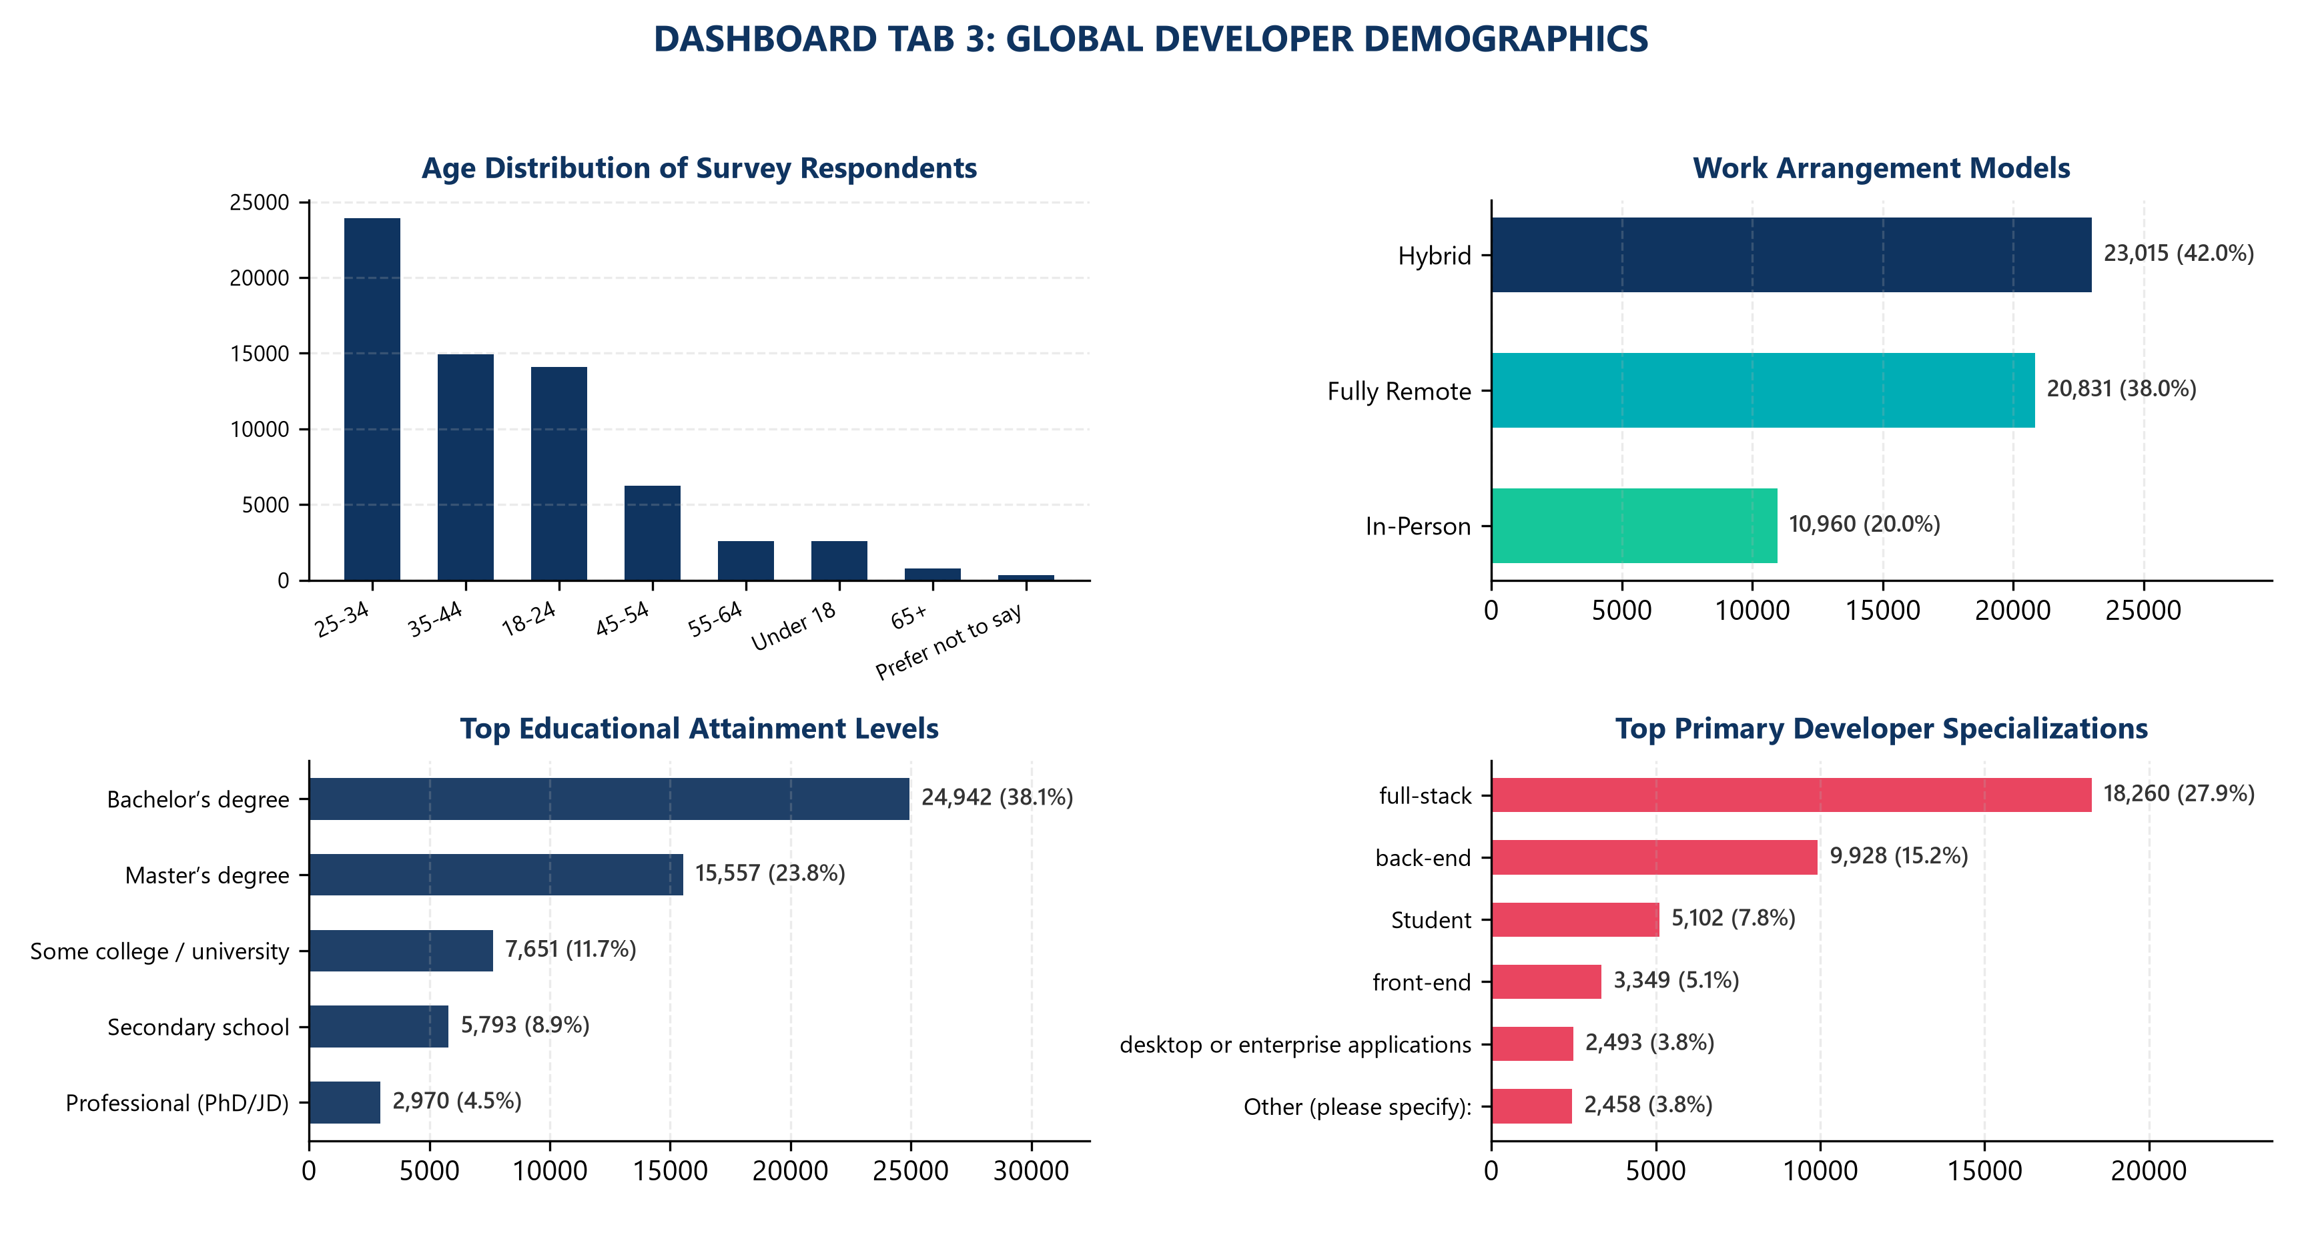
DASHBOARD TAB 3: Demographics
Tab 3: Demographics Insight
• Age Cohorts: The developer workforce is highly concentrated in early-to-mid career professionals: 25–34 years old (36.5%) and 35–44 years old (22.8%).
• Work Arrangement: 80.0% of reporting developers operate under remote-capable models (42.0% Hybrid, 38.0% Fully Remote), with only 20.0% fully in-person.
• Formal Education: Strong academic grounding characterizes the industry, with Bachelor's (38.1%) and Master's (23.8%) degrees accounting for nearly 62% of participants.
• Core Specializations: Full-stack developers (27.9%) and back-end engineers (15.2%) constitute the primary architectural backbone of technical teams.

Slide 17
DISCUSSION
Cross-Tabulation & Multi-Dimensional Synthesis
The Stability vs. Novelty Paradox: While developer interest strongly gravitates toward modern innovations (Rust, Go, Next.js, Edge Computing), operational enterprise stacks remain solidly anchored in mature, battle-tested technologies (SQL, PostgreSQL, JavaScript, AWS).
The Rise of Polyglot Architecture: Modern production applications rarely rely on single monolithic stacks; typical engineers leverage 3+ languages (JavaScript front-end, Python/Go microservices, SQL queries) and dual-layer persistence (PostgreSQL + Redis).
Workplace Geography Transformation: The consolidation of remote/hybrid work (80.0%) permanently decouples developer talent from geographic tech clusters, elevating the strategic importance of asynchronous collaboration tooling and cloud environments.
Data Quality & Methodological Caveats: As an opt-in survey of engaged technical contributors, results reflect enthusiast and professional developer mindshare rather than passive institutional IT deployments.

Slide 18
OVERALL FINDINGS & IMPLICATIONS
Cross-Cutting Empirical Findings
Consolidated Tech Anchors: JavaScript, Python, SQL, and PostgreSQL form the core quadrumvirate of the global software development ecosystem.
Decoupled Systems Momentum: Rust and Go represent the primary vector for future systems programming, driven by memory safety, concurrency, and microservice efficiency.
Permanent Remote Shift: The shift toward distributed engineering teams (80.0% remote/hybrid) is structural, reshaping team coordination and technical management practices.
Strategic Industry Implications
For Engineering Leaders: Standardize core architectures on robust open-source engines (PostgreSQL, TypeScript) while piloting Rust and Go in high-performance subsystems.
For Technical Hiring Teams: Prioritize foundational full-stack problem-solving and polyglot database competence over transient syntax memorization.
For Professional Developers: Combine broad full-stack literacy with deep specialization in cloud infrastructure, data pipelines, or high-concurrency systems.

Slide 19

CONCLUSION
Project Conclusion & Executive Takeaways
Analytical Objective Achieved: Successfully executed end-to-end data analysis across 65,437 global survey responses, establishing defensible empirical benchmarks for technical decision-makers.
Technology Modernization Blueprint: Documented the operational dominance of Python, PostgreSQL, and JavaScript, while quantifying future migration velocities toward Rust, Go, Next.js, and Cloudflare.
Workforce Reality Defined: Confirmed that hybrid/remote development is the established operating standard across the global software industry.
Methodological Integrity Upheld: Enforced transparent denominator tracking, strict deduplication, reproducible Python scripts, and ethical boundaries separating survey desire from verified hiring demand.

Slide 20
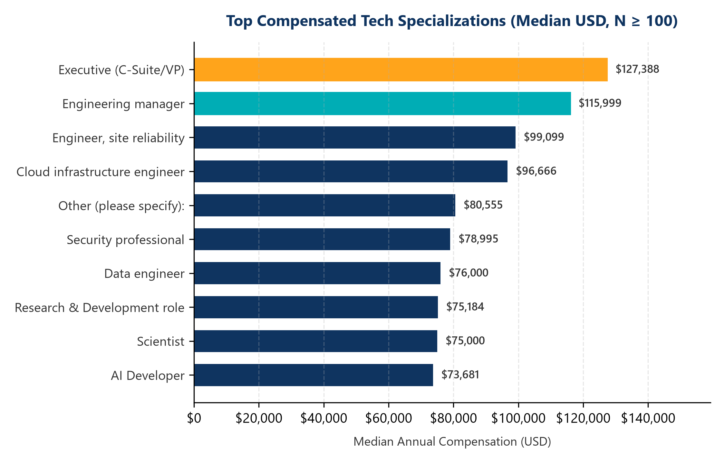

APPENDIX
Appendix: Compensation Architecture
• Sample Base: Evaluated across N=23,435 respondents with verified annual compensation (ConvertedCompYearly), filtered to roles with N ≥ 100.
• Leadership & Management: Engineering Managers ($116,000 median) and Senior Executives ($127,388 median) command peak market premiums.
• High-Value Technical Roles: Site Reliability Engineers ($99,099 median) and Cloud Infrastructure Engineers ($96,666 median) outperform general developer averages.
• Core Engineering Benchmarks: Data Engineers ($76,000 median), AI Developers ($73,681 median), and Full-Stack Developers reflect robust baseline enterprise demand.
• Denominator & Currency Note: Compensation converted to USD and adjusted across international exchange rates per Stack Overflow survey methodology.

